Slide 1
‘SAD!’ Pitch
Bio Hackathon 2019
N. Cizauskas
B. Kao
H. Thompson
R. Wallace
J. Yim

Slide 2
1 in 3
In the UK,
Suffer from Seasonal Affective Disorder.

Slide 3
Seasonal Affective Disorder (S.A.D.)
S.A.D. is a type of chronic depression that is reoccuring on seasonal intervals.
1 in 6 people in the UK report experiencing a common mental health symptom (depression, anxiety) in any given week.
Unipolar depressive disorders were ranked as the 3rd leading cause of the global burden of disease in 2004.
It is projected that they will move into the 1st place by 2030.
(World Federation For Mental Health (WFMH), 2012; World Health Organisation, 2001)
Notes:
This slide and the following slide should be explaining how our product is related to global health.
“Tell a story - form a narrative - that makes judges interested in why you’re making and developing a project.
Make them understand how your solution solves it, and as you go through the presentation, convince the judges why this idea fits all 5 criteria.”
Symptoms:
> a persistent low mood
> a loss of pleasure or interest in normal everyday activities
> feeling irritable
> feelings of despair, guilt and worthlessness
> low self-esteem
> tearfulness
> feeling stressed or anxious
> a reduced sex drive
> becoming less sociable
Perhaps mention:
Prevalence of depression in the world
How it affects people

Slide 4
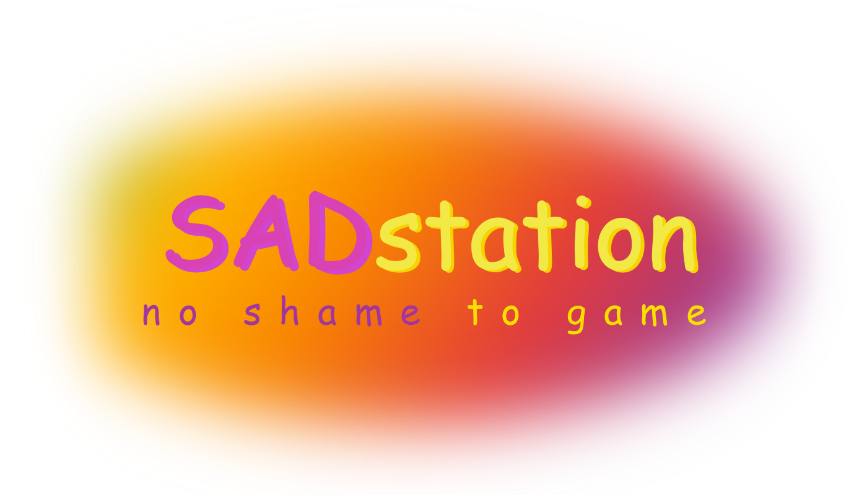
Our Solution
Notes:
This slide (with the following screenshots) should talk about the technological feasibility of the idea.

Slide 5
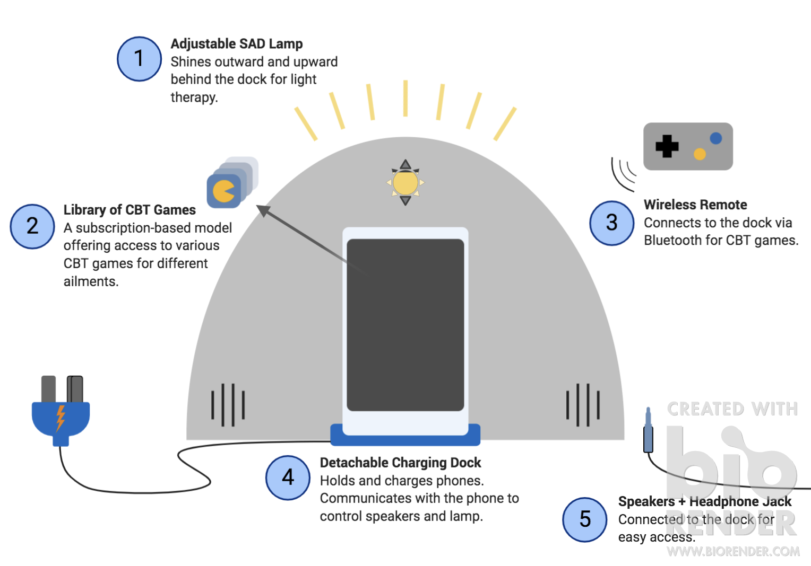
Our Product
Notes:
This slide introduces what the product is.
Our product, the SADstation, is an assistive therapeutic tool to treat and remove the symptoms of Seasonal Affective Disorder, among other mental illnesses.
The SADstation uses a SAD lamp along with a library of specially-designed games in order to provide light therapy and cognitive behavioral therapy, known as CBT.
As seen from the diagram, it comes with a number of useful features that allow for greater ease of use.
1: SAD Lamp
Light therapy is provided through an adjustable lamp to deal with all circumstances.
2: CBT Games + Remote
3: Detachable charging dock
Talk about ideas behind the CBT games + what they should be like.
Positive reinforcement
Explain the subscription model and the reason behind it:
Many games in order for people to continue their therapy
Some CBT games are more effective for certain types of mental illnesses; a library allows access to all of them, one-size-fits-all
Not all games will be appealing to those suffering from CBT
The ongoing revenue from subscriptions will allow the library to be maintained and updated as well, further sustainability

Slide 6
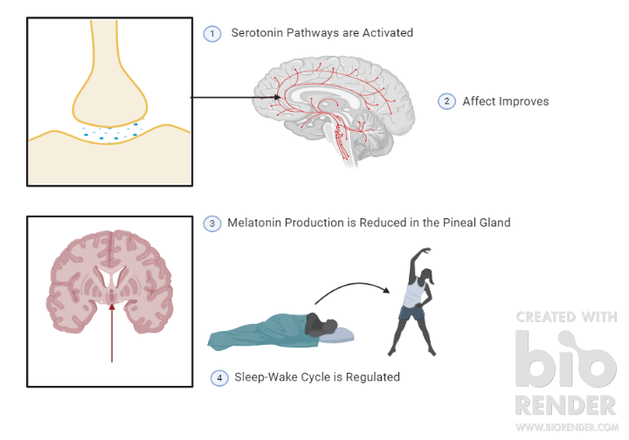
Light Therapy - How Does it Work?
Light therapy releases the neurotransmitter serotonin and reduces the production of melatonin.
It has also been shown to improve the wellbeing of patients with:
Sleep disorders
Jet lag
Other types of chronic depression
Adjustment to new sleep schedules
Dementia
Light therapy yields about 75% clinical remissions.
(Gallin et al., 1995; Terman & Terman, 2005; Wirz-Justice, 2018; Wirz-Justice et al., 1993)
Notes:
This slide reinforces the technological feasibility of the product, specifically on previous research on Light Therapy.
Serotonin is an essential neurotransmitter for regulating mood, appetite, sleep patterns, social behavior, libido, and memory. It is known as the “Happiness Hormone” - people diagnosed with different types of depression have decreased serotonin production.
Light Therapy increases serotonin in a natural and risk-free way. In addition to this, it helps pause the production of melatonin in the pineal gland - when used in the morning, this helps the patient feel more awake during the day.

Slide 7
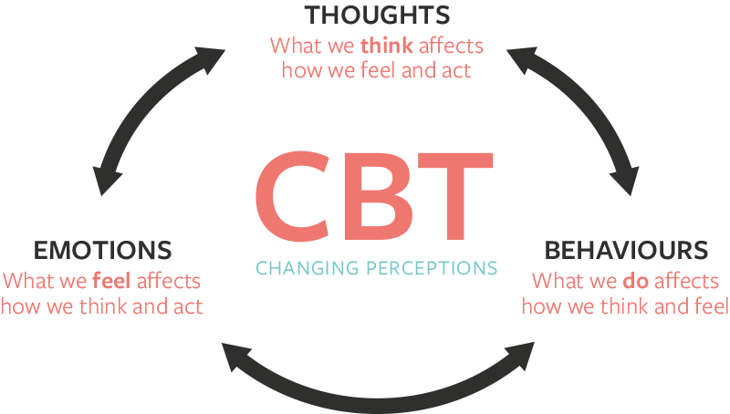
Cognitive Behavioral Game Design (CBGD)
Cognitive Behavioral Therapy helps patients with negative thinking patterns change those patterns into more positive, emotionally-viable thought processes.
CBGD games focus on task-orientated, self-effective problems.
Solutions use positive social interaction with NPCs, self-help oriented methods, and other positive and applicable actions.
(Bandura, 1978, 1991a, 1991b, 2012; Brezinka, 2014; Selmi et al., 1990; Starks, 2014)
Notes:
CBGD is already used widely to improve the well-being of individuals with anger management issues, social anxiety, symptoms of depression; it can be applied to any disorders treatable by CBT.
Bandura’s Social Cognitive Theory states that individual's knowledge acquisition can be directly related to observing others within the context of social interactions, experiences, and outside media influences.
Games can use fantasy problems that reflect the decision-making processes of real-world day-to-day problem - see the examples on the next slide.

Slide 8
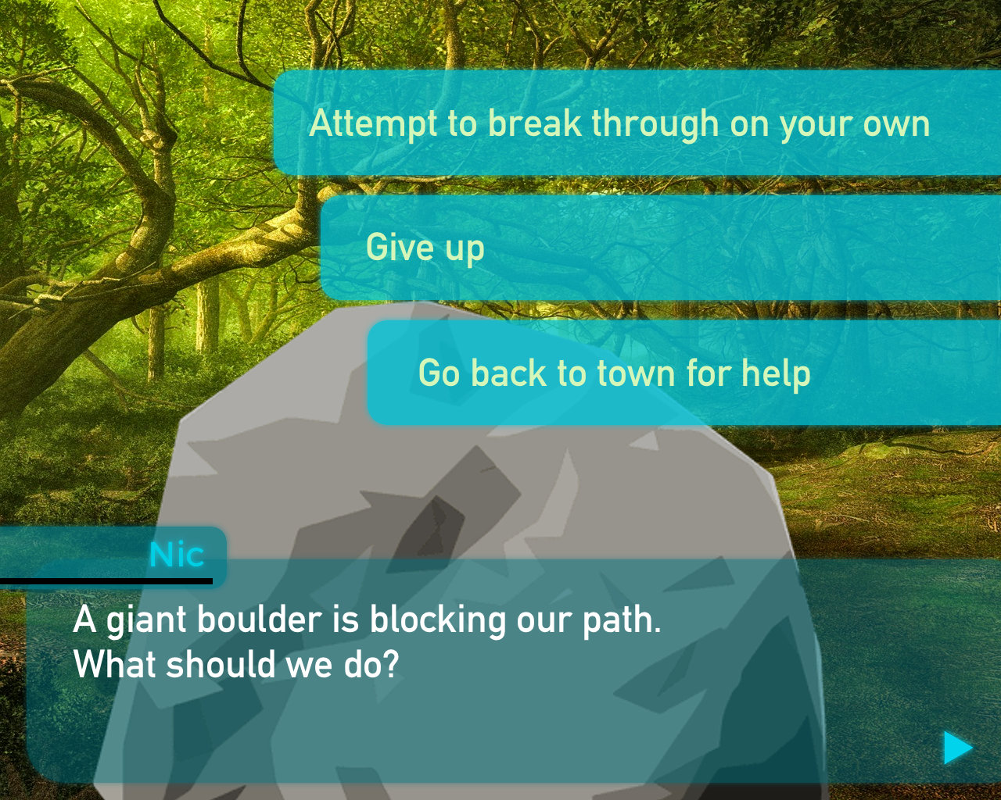
Notes:
<<Trains negative thinking patterns on the fear of asking others for help>>
Purpose of an NPC as a companion

Slide 9
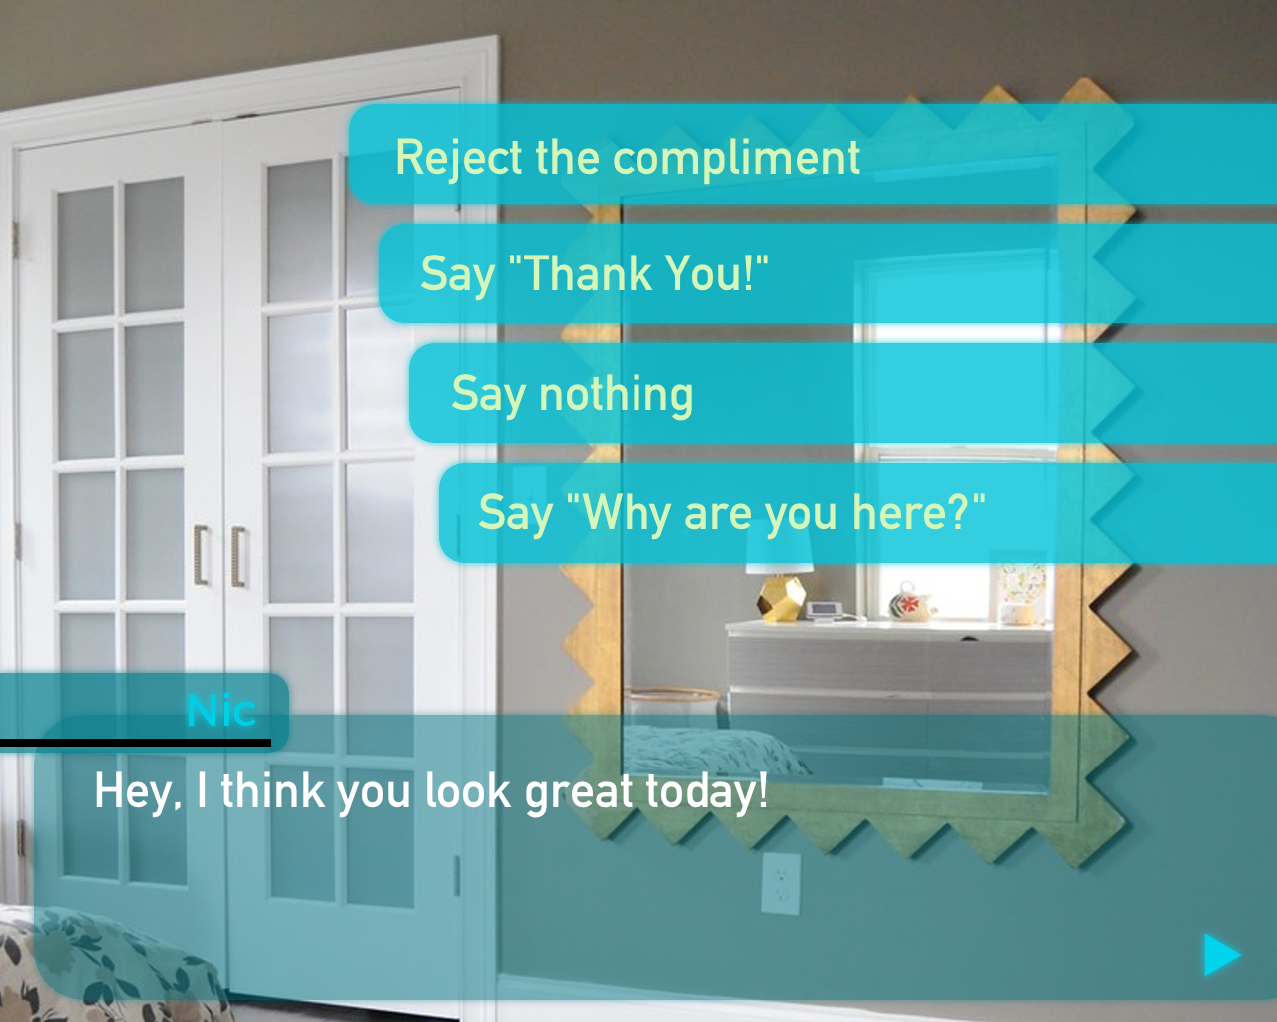
Notes:
What happens with ‘say nothing’?

Slide 10
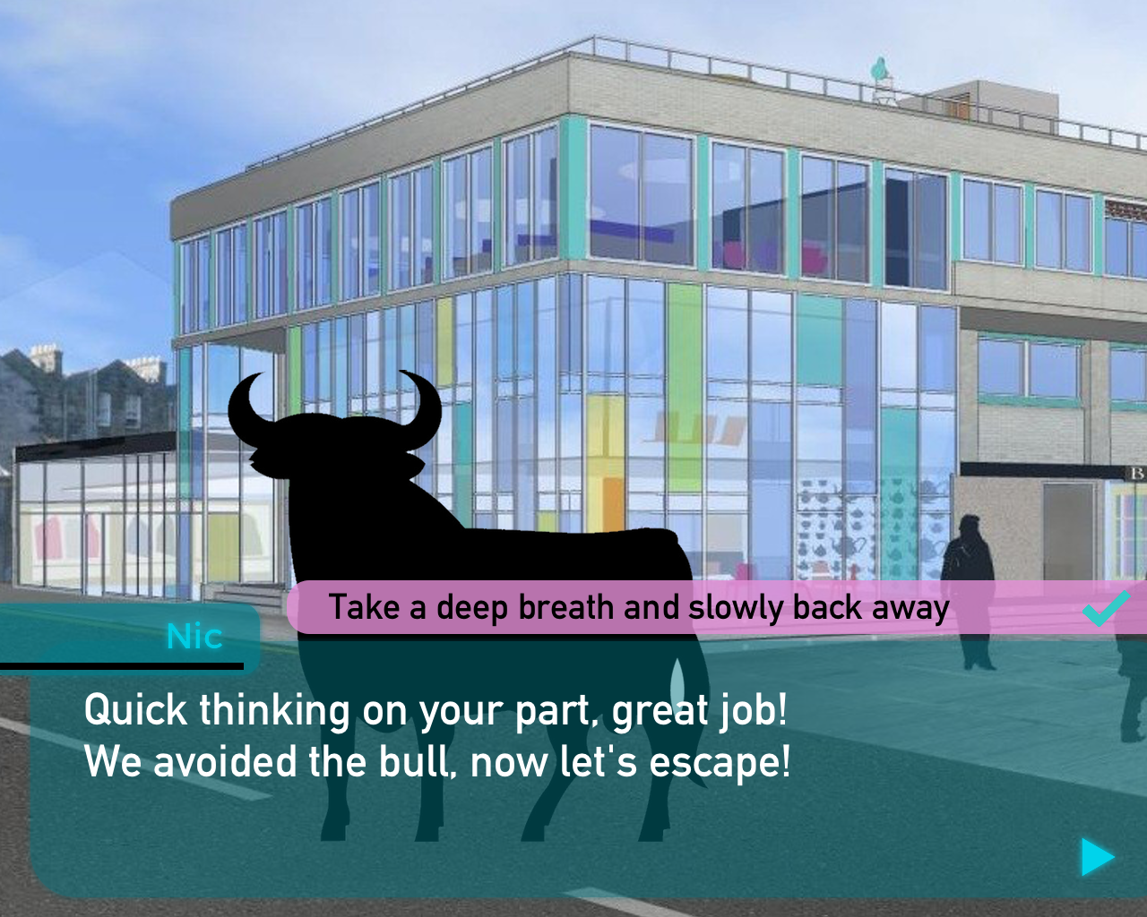

Slide 11
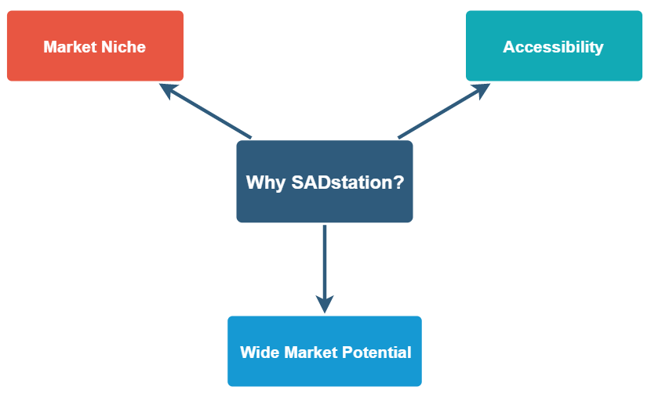
Notes:
Outline the product’s USP and Target Market.
Why is this different then just lamp or cbt game? It’s a combination of both (creates a new niche in the market), installs good therapy patterns - encouraged to spend proper amount of time in lamp therapy - two types of therapy combined (neurological therapy - serotonin, and psychosocial therapy - CBT)
MARKET NICHE:
There’s no other product available that combines Light therapy with CBT
Light therapy - releases serotonin +reduces melatonin - neurological treatment for physiological improvements, while
CBT - changes negative thinking patterns - psycho-social treatment for cognitive and behavioral benefits
HOLISTIC TREATMENT:
Covers all aspects of mental health treatment
expedities and improves treatment process
Allows customer base to have control overtreatment
Duration flexibility
private therapy
ACCESSIBILITY
Just need a mobile phone and port
Technology is easy to use
Easy to purchase and widely available
Ease of transport
WIDE MARKET POTENTIAL
Plan for scaling up
Global expansion potential
¼ in people in the world affected by a mental health disorder - around 450 million people in the world - there is a need within the global market
Potential translation of games (sociocultural difference may be a challenge but could be overcome by expert advice/ more investment)
Future R&D
SAD VR/AR
Consistent development, improvement, and updating of CBT games library
More model iterations of SADstation

Slide 12
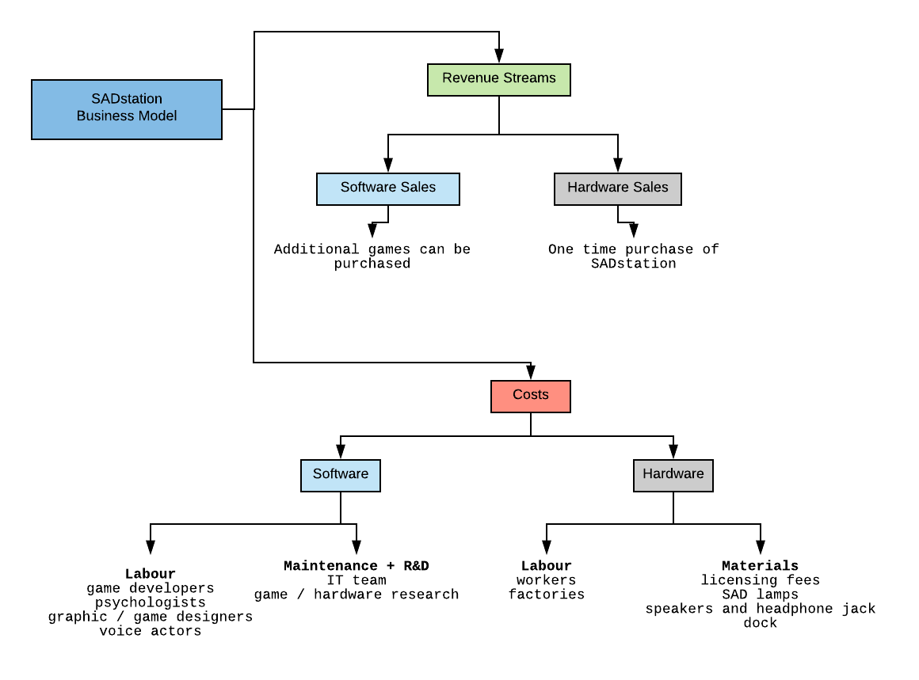
Business Model
Notes:
Outline the business model’s cost structures + revenue streams.

Slide 13
References
Bandura, A. (1978). Self-efficacy: Toward a unifying theory of behavioral change. Advances in Behaviour Research and Therapy. https://doi.org/10.1016/0146-6402(78)90002-4
Bandura, A. (1991a). Social cognitive theory of moral thought and action. Handbook of Moral Behavior and Development.
Bandura, A. (1991b). Social cognitive theory of self-regulation. Organizational Behavior and Human Decision Processes. https://doi.org/10.1016/0749-5978(91)90022-L
Bandura, A. (2012). Social cognitive theory. In Handbook of Theories of Social Psychology: Volume 1. https://doi.org/10.4135/9781446249215.n18
Brezinka, V. (2014). Computer games supporting cognitive behaviour therapy in children. Clinical Child Psychology and Psychiatry. https://doi.org/10.1177/1359104512468288
Gallin, P. F., Terman, M., Reme, C. E., Rafferty, B., Terman, J. S., & Burde, R. M. (1995). Ophthalmologic examination of patients with seasonal affective disorder, before and after bright light therapy. American Journal of Ophthalmology. https://doi.org/10.1016/S0002-9394(14)73874-7

Slide 14
References
Selmi, P. M., Klein, M. H., Greist, J. H., Sorrell, S. P., & Erdman, H. P. (1990). Computer-administered cognitive-behavioral therapy for depression. American Journal of Psychiatry. https://doi.org/10.1176/ajp.147.1.51
Starks, K. (2014). Cognitive behavioral game design: A unified model for designing serious games. Frontiers in Psychology. https://doi.org/10.3389/fpsyg.2014.00028
Terman, M., & Terman, J. S. (2005). Light therapy for seasonal and nonseasonal depression: Efficacy, protocol, safety, and side effects. CNS Spectrums. https://doi.org/10.1017/S1092852900019611
Wirz-Justice, A. (2018). Seasonality in affective disorders. General and Comparative Endocrinology. https://doi.org/10.1016/j.ygcen.2017.07.010
Wirz-Justice, A., Graw, P., Kräuchi, K., Gisin, B., Jochum, A., Arendt, J., … Pöldinger, W. (1993). Light Therapy in Seasonal Affective Disorder is Independent of Time of Day or Circadian Phase. Archives of General Psychiatry. https://doi.org/10.1001/archpsyc.1993.01820240013001
World Federation For Mental Health (WFMH). (2012). Depression: A Global Crisis. World Mental Health Day.
World Health Organisation. (2001). Mental disorders affect one in four people. World Health Organization. https://doi.org/10.1192/bjp.180.1.29

Slide 15
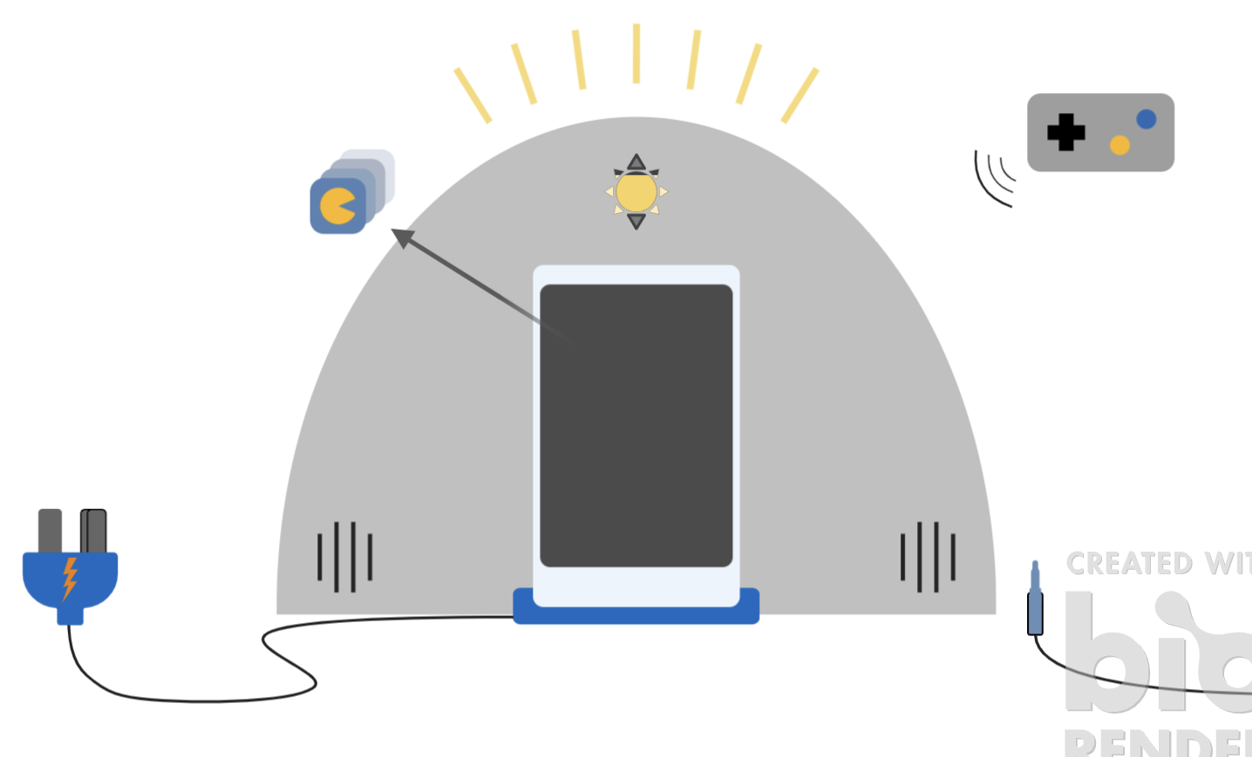
Thank You!

Slide 16
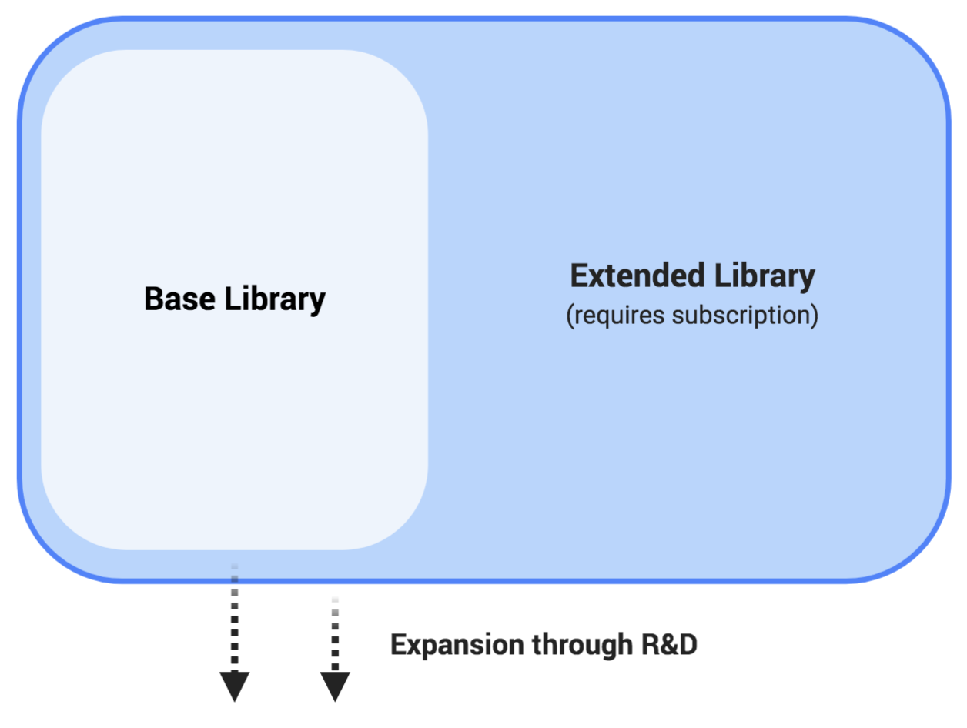
Subscription Model
The base library can be accessed without a subscription.
An extended library is available with a greater variety of CBT games.
We hope to expand upon both libraries through funding from subscriptions.
Projected costs of development should decrease with time.

